Slide 1
ASP.NET MVC CORE
Instructor: Edwin oduor

Slide 2

Quote of the day

Slide 3
Lesson objectives
Add bootstrap modal

Slide 4
Lesson pre-requisites
In order to take full advantage of this section you need to have the following;
Computer with Visual Studio Installed.
Stable Network Connection.

Slide 5
Training methods and extra readings
TRAINING METHODS FOR THIS LESSON
EXTRA READINGS
Lecturing Method – This is the main method of training to be adopted in this lesson with illustrations and practical coding examples.
Discussion Method - This method will be adopted periodically whereby learning will be derived principally from the students brainstorming together, rather than from the trainer. Three main types of discussions will be used:
Directed discussion
Developmental discussion
Problem-Solving discussion
Home and Learn C#

Slide 6
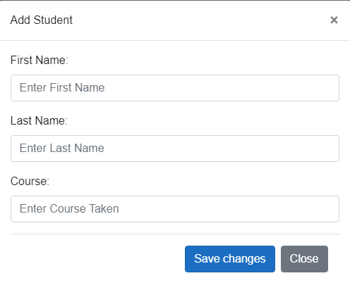
In this session will see how to add bootstrap modal pop up.
When add new student is clicked on a modal will pop up the user will enter the details and click on save the details will be saved in the database.
We will add the First modal together then the rest you will add on your own.
By clicking on add new student, the following modal will pop up.

Slide 7
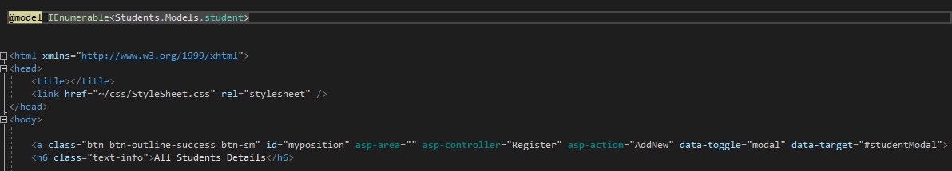
We will see how to add the modal in the previous page.
To add a modal will have a button when clicked the modal should pop up,
In our view we have details about the students and will display this in a table the following code will give us the output and display the students. (Next Slide)
Data- target ensures that the modal will be shown when the button is clicked at because that is the id of the modal that we want to pop up when the button is clicked on.
Button
Id of Modal

Slide 8
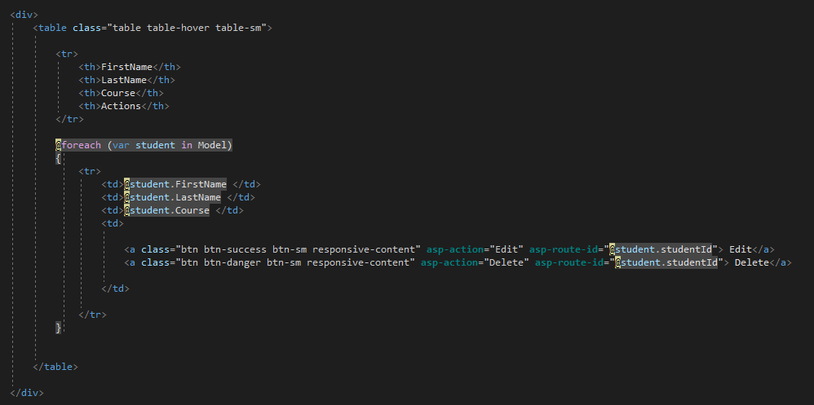

Slide 9
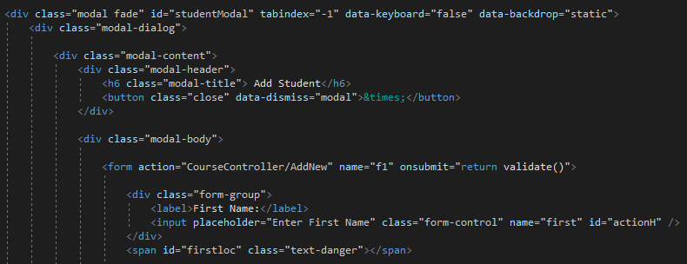
We are giving the modal an Id so that we will refer to it when a button has been clicked on so that the modal will pop up.
Id of the modal referring to

Slide 10
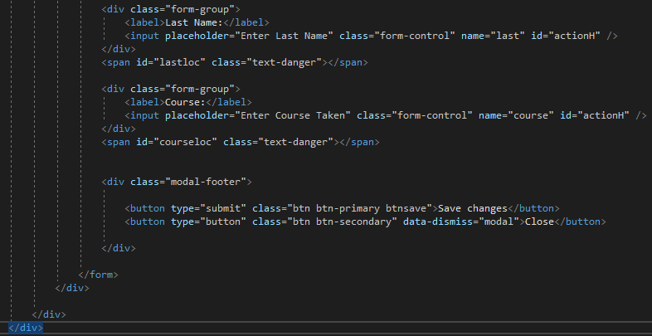

Slide 11
EXERCISE

Slide 12
With that achieved I believe now when the add new button is clicked on then a modal will pop up so that the user can now add a student in the system.
I want us to implement the same for the other views for the course and Fees so that a user can click on button add course then a modal will pop up and the same goes for Fees.

